Slide 1

7th Grade Accelerated Math
Unit 3, Lesson 5 Applying Exponent Laws Volume 1, pg. 124

Slide 2


Benchmark
MA.8.NSO.1.3
Extend previous understanding of the Laws of Exponents to include integer exponents. Apply the Laws of Exponents to evaluate numerical expressions and generate equivalent numerical expressions, limited to integer exponents and rational number bases, with procedural fluency.
volume 1, pg. 124

Slide 3
Integrated Mathematical Thinking and Reasoning Standards
MA.K12.MTR.3.1 Complete tasks with mathematical fluency.
MA.K12.MTR.4.1 Engage in discussions that reflect on the mathematical thinking of self and others.
MA.K12.MTR.5.1 Use patterns and structure to help understand and connect mathematical concepts.
volume 1, pg. 124
Notes:
4

Slide 4

Learning Target
I can apply the laws of exponents to generate equivalent numerical expressions.
volume 1, pg. 124

Slide 5

Warm-Up
volume 1, pg. 124

Slide 6

3.5.1 Warm-Up: Math Argument
Without performing any calculations, circle the expression you think has the greater value.
Justify why you selected that expression.
volume 1, pg. 124

Slide 7

Guided Instruction
volume 1, pg. 125

Slide 8
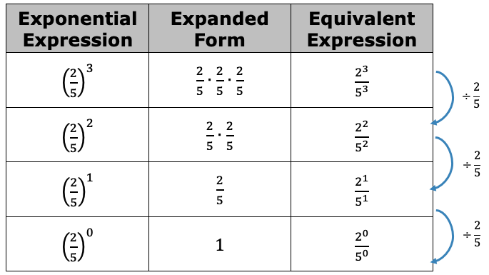
3.5.2 Guided Instruction: Rational Number Bases
Consider the table shown.
volume 1, pg. 125

Slide 9



Complete the statement to describe the pattern in the table.
As the value of the exponent by 1 in
the column on the left, the equivalent expression in
the column on the right can be found by.
the previous value by the
volume 1, pg. 125

Slide 10
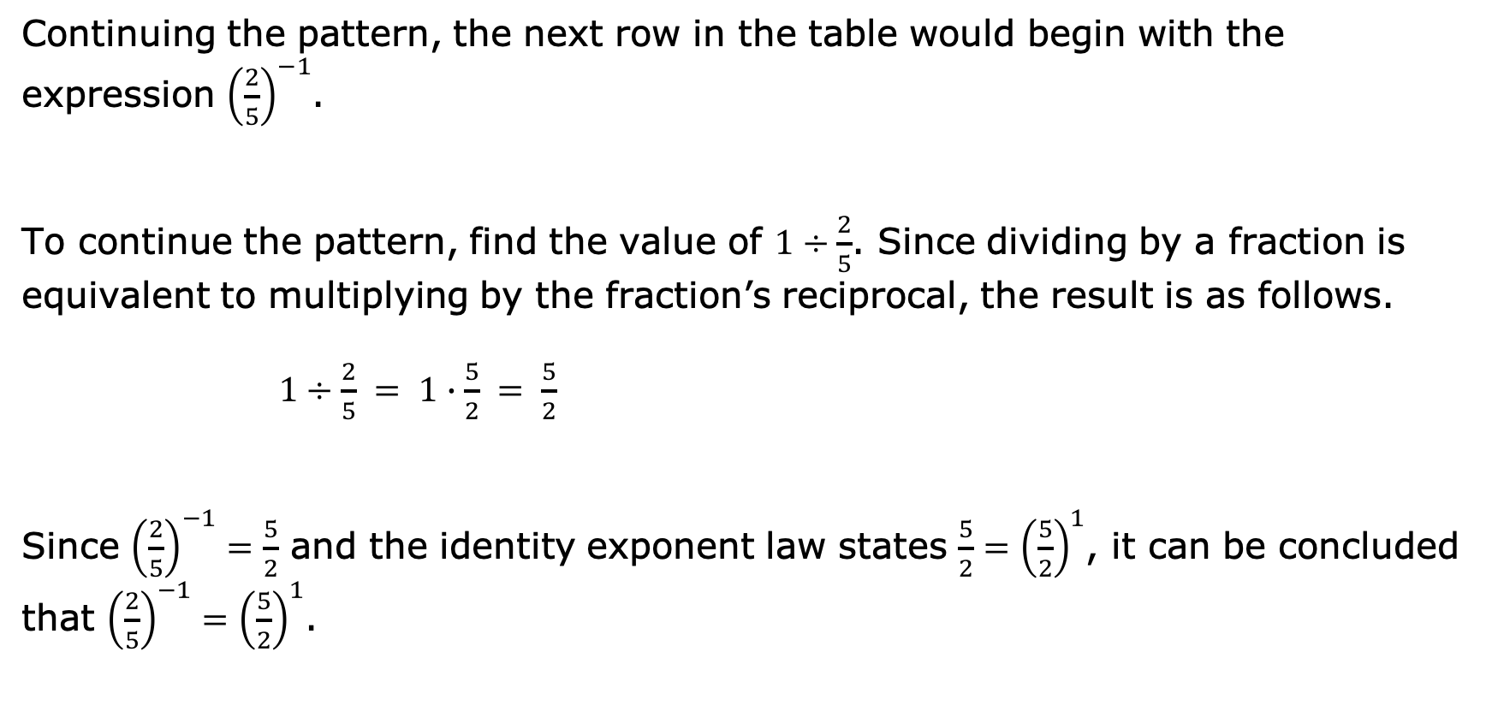
Continuing the pattern, the next row in the table would begin with the expression ${\left(\frac{2}{5}\right)}^{−1}$.
To continue the pattern, find the value of $1÷\frac{2}{5}$. Since dividing by a fraction is equivalent to multiplying by the fraction’s reciprocal, the result is as follows.
$1÷\frac{2}{5} = 1∙\frac{5}{2} = \frac{5}{2}$
Since ${\left(\frac{2}{5}\right)}^{−1}=\frac{5}{2}$ and the identity exponent law states $\frac{5}{2}={\left(\frac{5}{2}\right)}^{1}$, it can be concluded that ${\left(\frac{2}{5}\right)}^{−1}={\left(\frac{5}{2}\right)}^{1}$.
volume 1, pg. 125

Slide 11
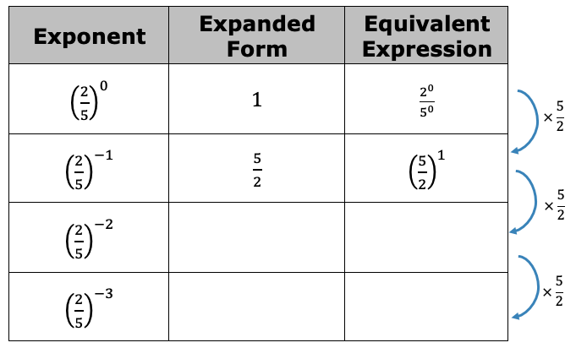
Continue the pattern.
volume 1, pg. 125

Slide 12

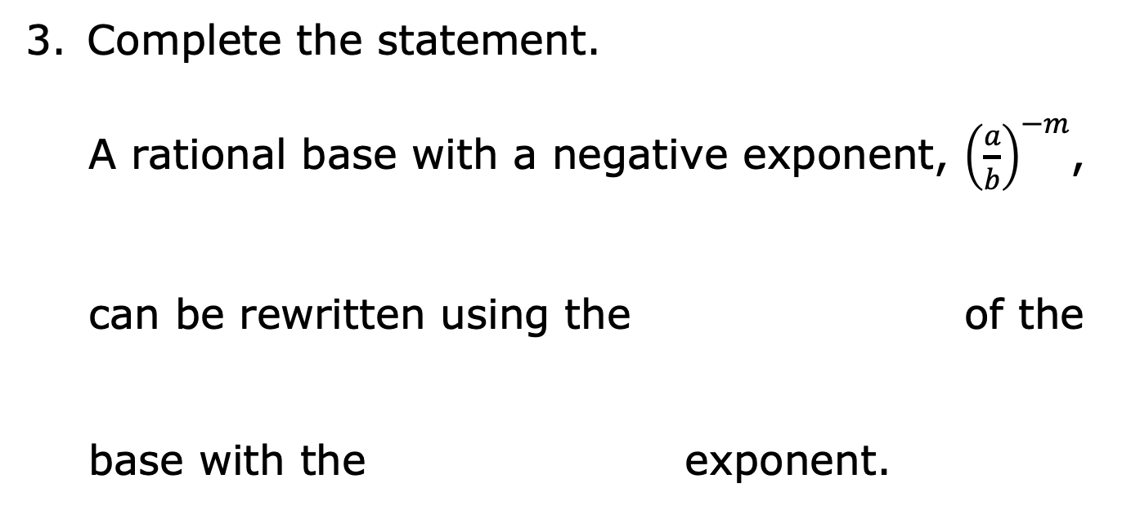
Complete the statement.
A rational base with a negative exponent, ${\left(\frac{a}{b}\right)}^{−m}$,
can be rewritten using the of the
base with the exponent.
volume 1, pg. 125

Slide 13

Rewrite each expression as an equivalent exponential expression with positive exponents.
${\left(\frac{2}{3}\right)}^{−4}=______________$
${\left(\frac{3}{−5}\right)}^{−9}=______________$
${\left(−\frac{8}{9}\right)}^{−2}=______________$
${\left(\frac{21}{4}\right)}^{−5}=______________$
volume 1, pg. 126

Slide 14

Collaboration
volume 1, pg. 126

Slide 15

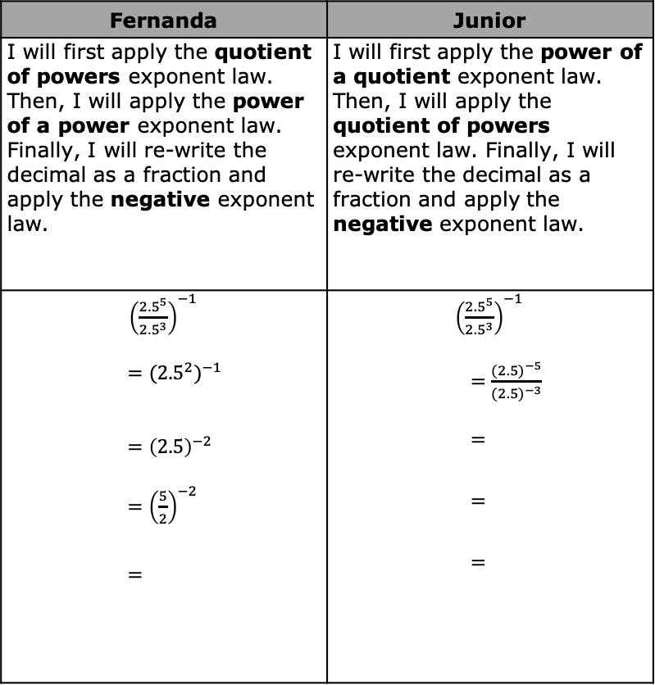
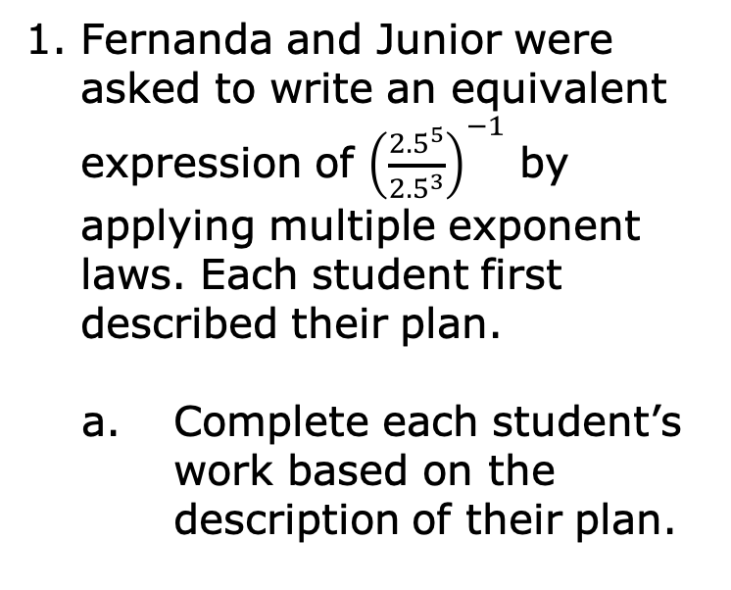
3.5.3 Collaboration: Applying More Than One Exponent Law
Fernanda and Junior were asked to write an equivalent expression of ${\left(\frac{{2.5}^{5}}{{2.5}^{3}}\right)}^{−1}$ by applying multiple exponent laws. Each student first described their plan.
Complete each student’s work based on the description of their plan.
Fernanda | Junior
I will first apply the quotient of powers exponent law. Then, I will apply the power of a power exponent law. Finally, I will re-write the decimal as a fraction and apply the negative exponent law. | I will first apply the power of a quotient exponent law. Then, I will apply the quotient of powers exponent law. Finally, I will re-write the decimal as a fraction and apply the negative exponent law.
${\left(\frac{{2.5}^{5}}{{2.5}^{3}}\right)}^{−1}$ $$={{(2.5}^{2})}^{−1 }$$ $$={\left(2.5\right)}^{−2}$$ $={\left(\frac{5}{2}\right)}^{−2}$ $$=$$ | ${\left(\frac{{2.5}^{5}}{{2.5}^{3}}\right)}^{−1}$ $=\frac{{(2.5)}^{−5}}{{(2.5)}^{−3}}$ $$=$$ $$=$$ $$=$$
volume 1, pg. 126

Slide 16
Explain which method you prefer.
Ask your partner which method they prefer. Summarize your partner’s explanation.
volume 1, pg. 127

Slide 17
Collaboration
volume 1, pg. 127

Slide 18
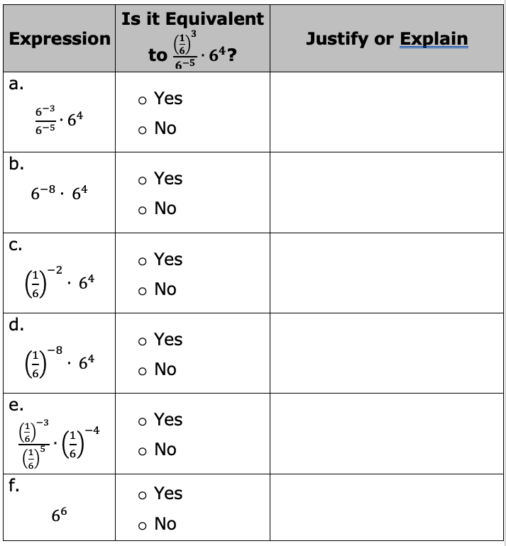
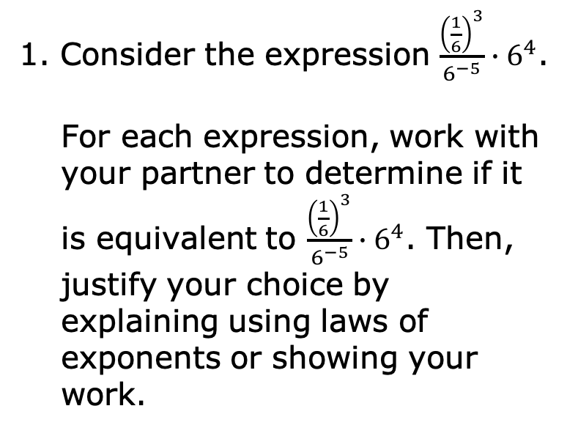
3.5.4 Collaboration: Equivalent Expressions
Consider the expression $\frac{{\left(\frac{1}{6}\right)}^{3}}{6^{−5}}∙6^{4}$.
For each expression, work with your partner to determine if it is equivalent to $\frac{{\left(\frac{1}{6}\right)}^{3}}{6^{−5}}∙6^{4}$. Then, justify your choice by explaining using laws of exponents or showing your work.
volume 1, pg. 127

Slide 19

Your Turn
volume 1, pg. 128

Slide 20
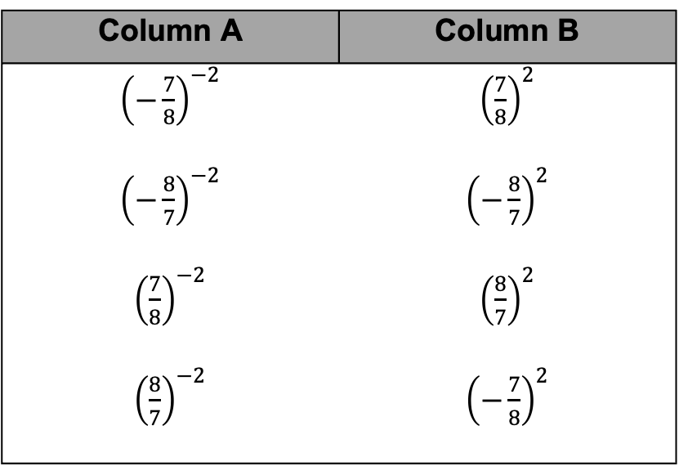
3.5.5 Your Turn!
Match each expression in Column A to an equivalent expression in Column B by drawing arrows.
Column A | Column B
${\left(−\frac{7}{8}\right)}^{−2}$ | ${\left(\frac{7}{8}\right)}^{2}$
${\left(−\frac{8}{7}\right)}^{−2}$ | ${\left(−\frac{8}{7}\right)}^{2}$
${\left(\frac{7}{8}\right)}^{−2}$ | ${\left(\frac{8}{7}\right)}^{2}$
${\left(\frac{8}{7}\right)}^{−2}$ | ${\left(−\frac{7}{8}\right)}^{2}$
volume 1, pg. 128

Slide 21
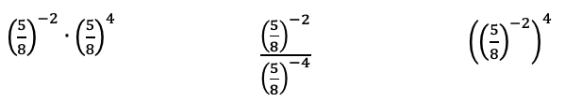
Three expressions are shown. Circle the two expressions that are equivalent.
volume 1, pg. 128

Slide 22
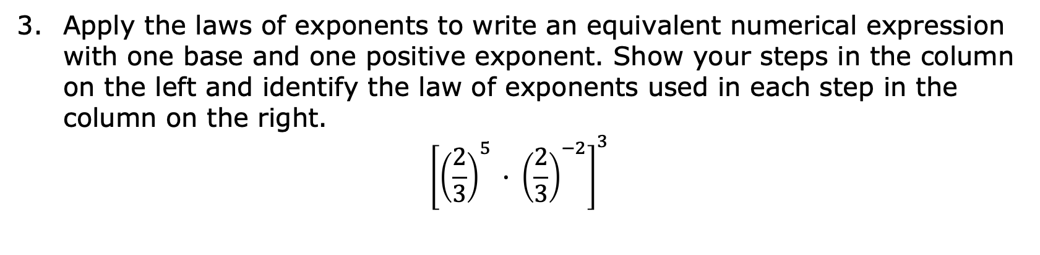
Apply the laws of exponents to write an equivalent numerical expression with one base and one positive exponent. Show your steps in the column on the left and identify the law of exponents used in each step in the column on the right.
$${\left[{\left(\frac{2}{3}\right)}^{5} ∙ {\left(\frac{2}{3}\right)}^{−2}\right]}^{3}$$
Steps | Laws of Exponents
volume 1, pg. 128

Slide 23

Wrap-Up
volume 1, pg. 129

Slide 24
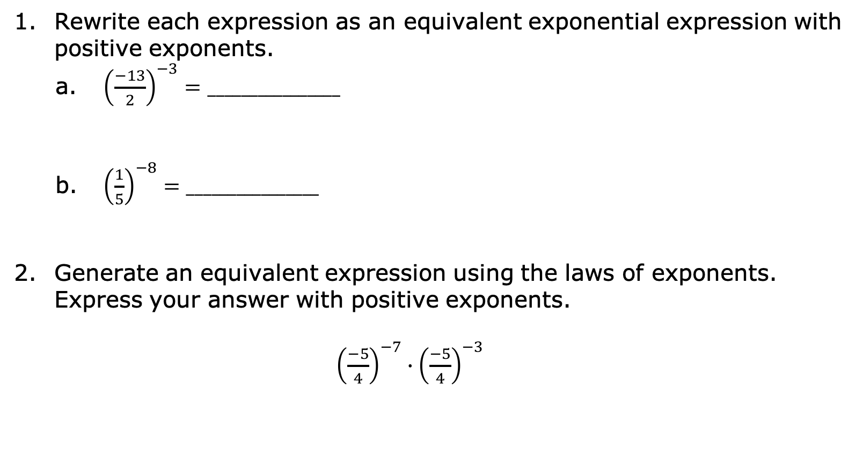
3.5.6 Wrap-Up: Ticket Out the Door
Rewrite each expression as an equivalent exponential expression with positive exponents.
${\left(\frac{−13}{2}\right)}^{−3}=________________$
${\left(\frac{1}{5}\right)}^{−8}=________________$
Generate an equivalent expression using the laws of exponents. Express your answer with positive exponents.
${\left(\frac{−5}{4}\right)}^{−7}∙{\left(\frac{−5}{4}\right)}^{−3}$
volume 1, pg. 129

